Slide 1
D. RAMA KRISHNA RAJU
Final Project

Slide 2
KEY LOGGER AND SECURITY

Slide 3


AGENDA
Introduction
Problem Statement
Project Overview
End Users
Solution and Value Proposition
The "Wow" Factor in Our Solution
Modelling
Results
3/21/2024 Annual Review

Slide 4
PROBLEM STATEMENT
Problem:
*Keyloggers are a significant threat to cybersecurity
*leading to unauthorized access to sensitive information
*identity theft and financial fraud.
Impact:
Affects individuals
*businesses and organizations bycompromising data privacy and security.

Slide 5
PROJECT OVERVIEW
Objective:
*Develop a comprehensive understanding of keyloggers
*how they work and effective security measures toprevent keylogging attacks.
Scope:
*Includes an analysis of hardware and software keyloggers
*legal and ethical implications
*security measures and best practices.

Slide 6

WHO ARE THE END USERS?
Individuals: Concerned about personal data security and privacy.
Businesses: Need to protect corporate data and ensure compliance with security standards.
Organizations: Require robust security measures to safeguard sensitive information.
Security Professionals: Aim to understand and mitigate keylogging threats.

Slide 7
YOUR SOLUTION AND ITS VALUE PROPOSITION
To avoid keyloggers
Use anti virus program
Use password manager
Use multi factor authentication
Use a firewall
Avoid suspicious links and downloads
Change password periodically
Update your system
Use Virtual Keyboard to type passwords and sensitive
information

Slide 8
YOUR SOLUTION AND ITS VALUE PROPOSITION
Solution: Implement a multi-layered security strategy that
includes anti-keylogging software, regular system scans,
software updates,and user education.
Value Proposition:
Enhanced Security: Reduces the risk of data breaches and
identity theft.
User Awareness: Educates users about keylogging threats and
protection methods.
Compliance: Helps businesses and organizations comply with
data protection regulations.

Slide 9
THE WOW IN YOUR SOLUTION
Innovative Approach: Combining technical measures with
user education for comprehensive protection.
Demonstration: Real-time demonstration of a simple keylogger
to illustrate the threat and the effectiveness of security measures.
Impact: Significant reduction in the likelihood of keylogging attacks
through proactive measures.
9

Slide 10
MODELLING
Modular Design: The keylogger code is structured into modular functions for better readability and maintenance.
Event Handling: Utilizes the pynput library to capture and handle keyboard events.
Data Logging: Implements functions to log captured data into text and JSON files.
10

Slide 11
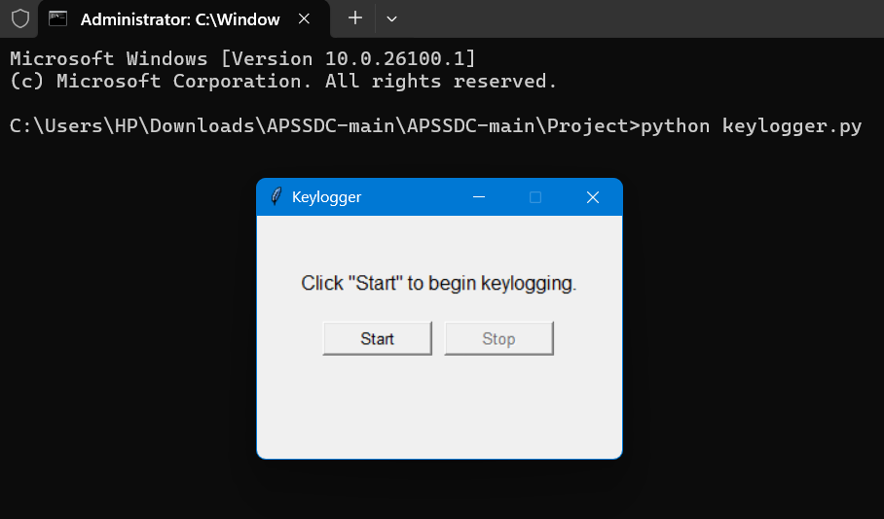
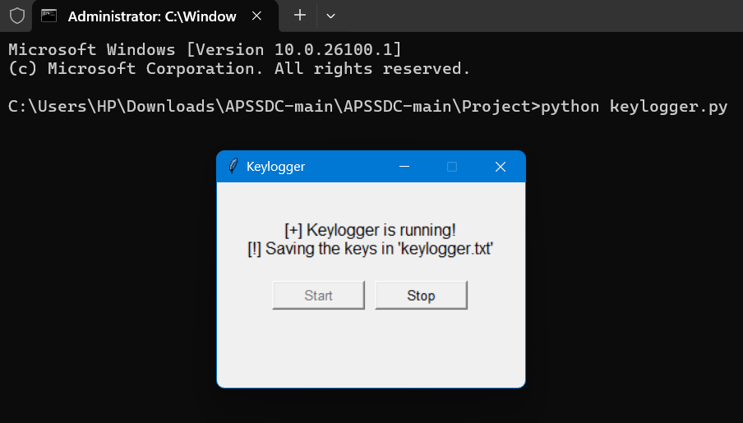
RESULTS:
11

